Slide 1
L^{A}T_{E}X

Slide 2
OBJECTIVES
INTRODUCTION
LAT_{E}X BASICS
MATH
IMAGES
BIBLIOGRAPHY
CONCLUSION
OBJECTIVES
Introduction to L^{A}T_{E}X
Hands-on
⁻ Basics of L^{A}T_{E}X
⁻ Math environments & commands
⁻ Including graphics
⁻ Creating Bibliography
Helpful hints & resources

Slide 3
OBJECTIVES
INTRODUCTION
LAT_{E}X BASICS
MATH
IMAGES
BIBLIOGRAPHY
CONCLUSION
L^{A}T_{E}X IS LIKE MS WORD, ONLY BETTER !
What is L^{A}T_{E}X?
Pronounced as ’lay-tech’ or ’lah-tech’
Document preparation system for high-quality typesetting
Uses markup commands and a type setting program T_{E}X
Used for publishing reports, books, scientific documents, etc

Slide 4
OBJECTIVES
INTRODUCTION
LAT_{E}X BASICS
MATH
IMAGES
BIBLIOGRAPHY
CONCLUSION
L^{A}T_{E}X SAVES FORMATTING TIME AND EFFORT
Concentrate on writing (content), NOT on formatting (appearance)
why use L^{A}T_{E}X?
Consistent layout, fonts, tables etc. throughout the presentation
Mathematical formulae can be easily typeset
Indices, references, footnotes can be easily generated

Slide 5
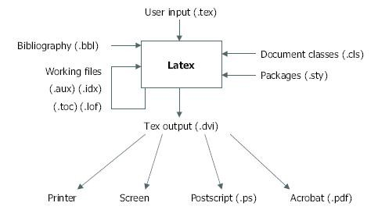
OBJECTIVES
INTRODUCTION
LAT_{E}X BASICS MATH
IMAGES
BIBLIOGRAPHY
CONCLUSION
HOW DOES L^{A}T_{E}X WORK?
Source text marked up with logical structure (like HTML)
Document class tells L^{A}T_{E}X how to format the content

Slide 6
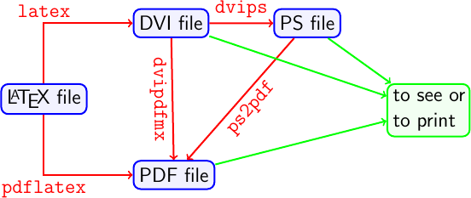
OBJECTIVES
INTRODUCTION
LAT_{E}X BASICS
MATH
IMAGES
BIBLIOGRAPHY
CONCLUSION
L^{A}T_{E}X OUTPUT FORMATS
Output formats available
DVI - Device Independent file format
PS - PostScript file format
PDF - Portable Document Format

Slide 7
OBJECTIVES
INTRODUCTION
LAT_{E}X BASICS
MATH
IMAGES
BIBLIOGRAPHY
CONCLUSION
SETTING UP L^{A}T_{E}X
LaTeX can be used in two modes
Off - line LateX platform
Latex distribution + Latex editor
MiKTeX
MacTeX
ProTeX, etc.
Online lateX platform
Overleaf
Pa peeria
ShareLateX, etc

Slide 8
Linux
Most distributions have a T_{E}Xsystem including L^{A}T_{E}X. Check software source for a T_{E}Xpackage, otherwise install TexLive directly
Mac OS X
MacTex - A full T_{E}X system including L^{A}T_{E}X
Windows
proTeXt - Easy to install complete L^{A}T_{E}X system
Download MikTeX and TeXnicCenter separately

Slide 9
LaTeX Document Structure
\documentclass{article} → Document class
\usepackage{graphics} → Packages used /Optional
\begin{document} → Main body / document
This is my first latex file.
\end{document}

Slide 10
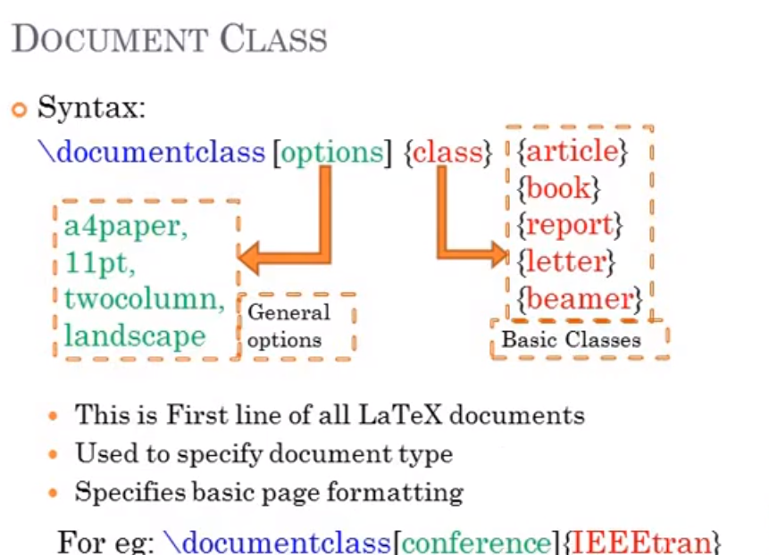

Slide 11
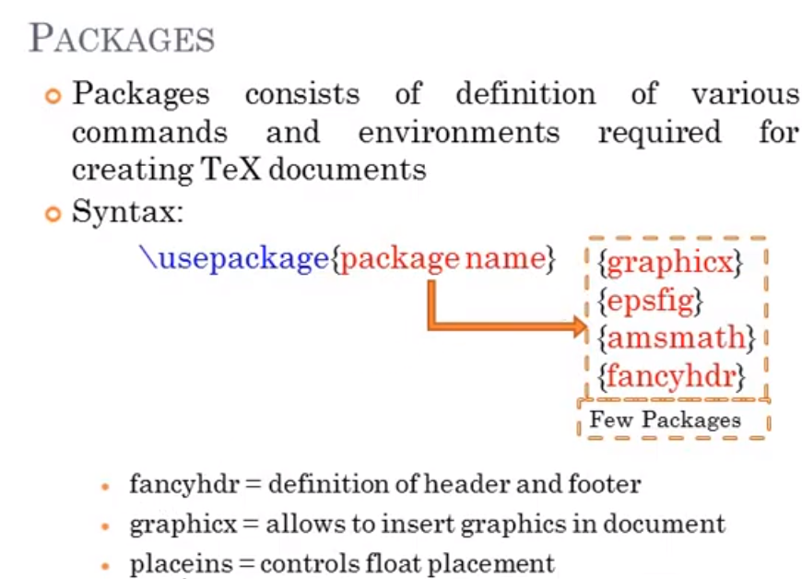

Slide 12
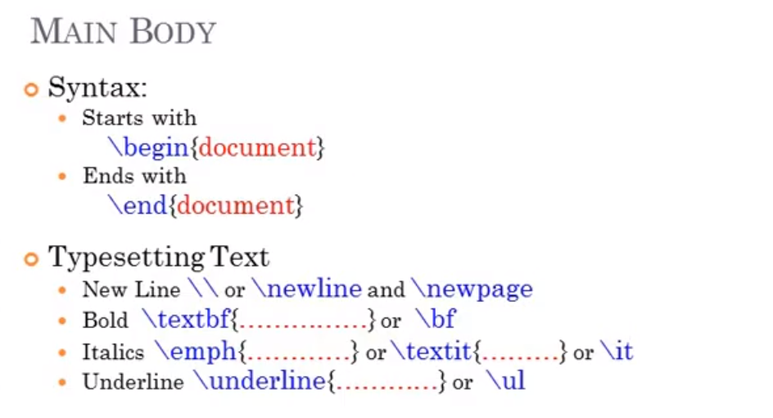

Slide 13
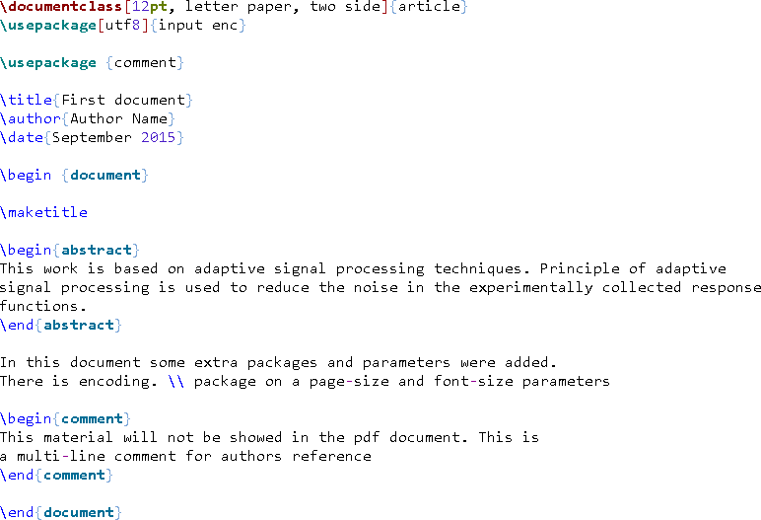

OBJECTIVES
INTRODUCTION
LAT_{E}X BASICS
MATH
IMAGES
BIBLIOGRAPHY
CONCLUSION

Slide 14
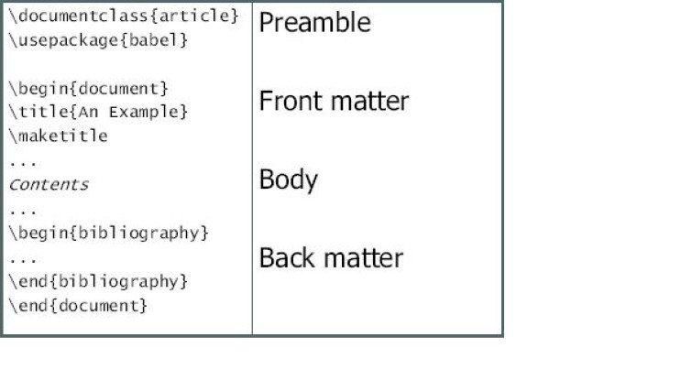
OBJECTIVES INTRODUCTION LAT_{E}X BASICS MATH IMAGES BIBLIOGRAPHY
UNDERSTANDING THE CODE & STRUCTURE
Preamble of a document
Basic formatting: abstract, paragraphs & newline
Environments - Paragraph style and formatting
CONCLUSION

Slide 15
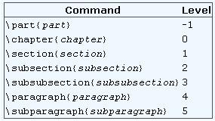
OBJECTIVES
INTRODUCTION
LAT_{E}X BASICS MATH
IMAGES
BIBLIOGRAPHY
CONCLUSION
SECTIONING COMMANDS
L^{A}T_{E}X can organize, number and index chapters and sections of a document. There are upto 7 levels of depth for defining sections depending on the document class.
\part and \chapter are only available in report and book document classes.

Slide 16
Numbered and unnumbered sections
To get an unnumbered chapter, section, sub-section, etc. add an asterisk before the opening curly brace. These will not go into the table of contents.
To add an unnumbered section to the table of contents, use the \addcontentsline command like this:
\addcontentsline{toc}{section}{Title of the section}

Slide 17
Table of contents
To create the table of contents is straightforward, the command \tableofcontents does the job.
\documentclass{article}
\title{Sections and Chapters}
\author{Gubert Farnsworth}
\date{ }
\begin{document}
\maketitle
\tableofcontents
\section{Introduction} This is the first section.. Nullam nec mi et neque pharetra sollicitudin. Praesent imperdietmi nec ante. Donec ullamcorper, felis non sodales...
\addcontentsline{toc}{section}{Unnumbered Section} \section*{Unnumbered Section}
\end{document}

Slide 18
Change the title of the table of contents
The default title for the table of contents is "Contents", this can be changed into whatever you need.
\renewcommand*\contentsname{Summary}

Slide 19
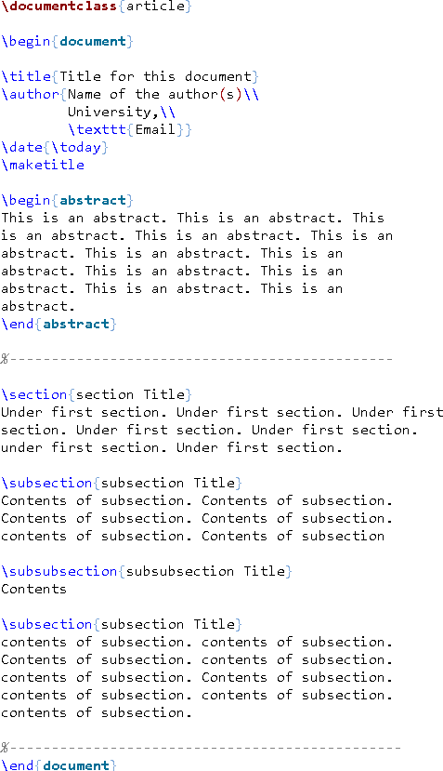
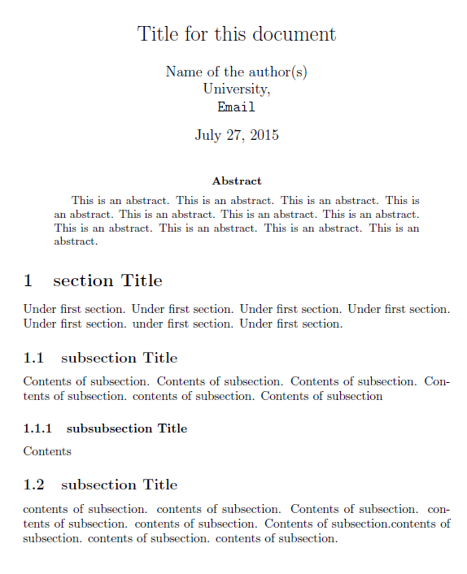
OBJECTIVES
INTRODUCTION
LAT_{E}X BASICS
MATH
IMAGES
BIBLIOGRAPHY
CONCLUSION

Slide 20
OBJECTIVES
INTRODUCTION
LAT_{E}X BASICS
MATH
IMAGES
BIBLIOGRAPHY
CONCLUSION
BULLETS & NUMBERING
Unordered Lists
Ordered Lists
\begin{itemize}
\begin{enumerate}
\item Item 1
\item Item 1
\item Item 2
\item Item 2
....
\end{itemize}
The default labeling scheme:
....
\end{enumerate}
The default numbering scheme: Level 1 - 1,2,3...
Level 2 - a,b,c...
Level 3 - i,ii,iii...
Level 4 - A,B,C...
Level 1 - \bullet (•)
Level 2 - (-)
Level 3 - \ast (∗)
Level 4 - \cdot (·)

Slide 21
List are basic elements in a document, when used correctly they keep concepts organized and structured.
Unordered lists
The unordered (unnumbered) lists are produced by the itemize environment. Each entry must be preceded by the control sequence \item.
\begin{itemize}
\item The individual entries are indicated with a black dot, a so-called bullet.
\item The text in the entries may be of any length.
\end{itemize}
By default the individual entries are indicated with a black dot, so-called bullet. The text in the entries may be of any length.

Slide 22
Ordered lists
Ordered list have the same syntax inside a different environment:
\begin{enumerate}
\item The labels consists of sequential numbers.
\item The numbers starts at 1 with every call to the enumerate environment.
\end{enumerate}
The ordered lists are generated by a \enumerate environment and each entry must be preceded by the control sequence \item, which will automatically generate the number labelling the item. The enumerate labels consists of sequential numbers, these numbers starts at 1 with every call to the enumerate environment.

Slide 23
Nested Lists
In LaTeX you can insert a list inside another list. The above lists may be included within one another, either mixed or of one type, to a depth of four levels.
\begin{enumerate}
\item The labels consists of sequential numbers.
\begin{itemize}
\item The individual entries are indicated with a black dot, a so-called bullet.
\item The text in the entries may be of any length.
\end{itemize}
\item The numbers starts at 1 with every call to the enumerate environment.
\end{enumerate}

Slide 24
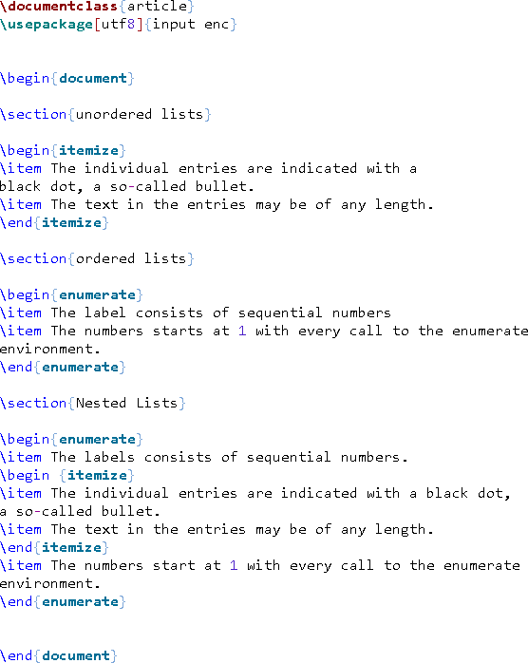
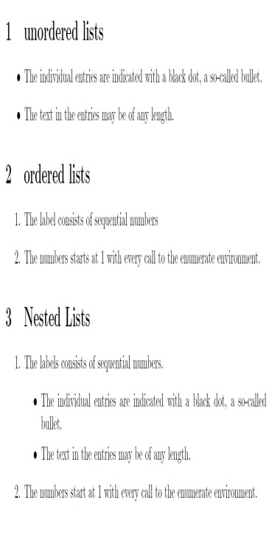
OBJECTIVES
INTRODUCTION
LAT_{E}X BASICS
MATH
IMAGES
BIBLIOGRAPHY
CONCLUSION

Slide 25
Bold, italics and underlining
Italicized text
To make a text italic is straightforward, use the \emph or \textit command:
Ex:- Some of the greatest discoveries in science were made by \emph{accident}.
Bold text
To make a text bold use \textbf command:
Ex:- Some of the \textbf{greatest} discoveries in science were made by accident.
Underlined text
Underlining text is very simple too, use the \underline command:
Ex: Some of the greatest discoveries in \underline{science} were made by accident.

Slide 26
OBJECTIVES INTRODUCTION LAT_{E}X BASICS MATH IMAGES BIBLIOGRAPHY
MATHEMATICAL MODES
Inline mode - Write formulas as a part of the text.
CONCLUSION
Math Environment - \begin{math}...\end{math}
L^{A}T_{E}X shorthand − \(...\)
T_{E}X shorthand − $...$
The formula (a + b)² = a² + b² + 2ab is in inline mode.
Display mode - Write formulas that are not a part of the text/paragraph, thus put on separate lines.
Math Environment - \begin{equation}...\end{equation}
L^{A}T_{E}X shorthand − \[...\]
T_{E}X shorthand − $$...$$
The same formula
(a + b)² = a² + b² + 2ab is in display mode.

Slide 27
OBJECTIVES
INTRODUCTION
LAT_{E}X BASICS
MATH
IMAGES
BIBLIOGRAPHY
CONCLUSION
MATHEMATICAL COMMANDS
Fractions
x+y
\frac{x + y}{y − z} = _{y−z}
1 ₊ 1
\frac{frac{1}{x} + frac{1}{y}}{z} =
x y
z
Subscript and Superscript
Superscript: x ˆ n = x^{n}; xˆ{2n} = x^{2n}
Subscript: x n = x_{n}; x {2n} = x_{2n}
Roots
.
\sqrt[5]{\frac{x + y}{y − z}} =
Brackets
5
x+y y−z
(\frac{x + y}{z})ˆ2\times(\frac{x
ˆ2}{yˆ
x+y
2
_{x}2
3}) = ( ) × ( _{y3} )
z

Slide 28
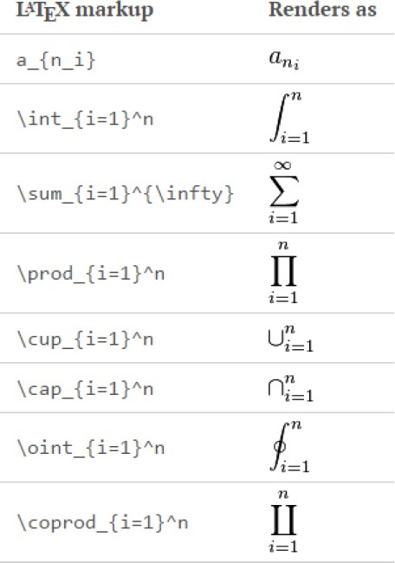
OBJECTIVES
INTRODUCTION
LAT_{E}X BASICS MATH
IMAGES
BIBLIOGRAPHY
CONCLUSION
ADDITIONAL OPERATORS

Slide 29
OBJECTIVES
INTRODUCTION
LAT_{E}X BASICS
MATH
IMAGES
BIBLIOGRAPHY
CONCLUSION
MATH EXERCISE
Buzz LightYear: To ∞ and beyond!
^{n}C_{r} = _{r}
n!
!(n−r)!
50 apples ×100 apples = lots of apples
Σ
n ₌ n(n+1) i=1 2
►

Slide 30
OBJECTIVES
INTRODUCTION
LAT_{E}X BASICS
MATH
IMAGES
BIBLIOGRAPHY
CONCLUSION
SOLUTIONS
Buzz LightYear: To $\infty$ and beyond!
{ ˆ n}C r = \frac{n!}{r!(n − r)!}
$50$ apples $\times\textbf {100}$ apples = lots of apples
$\sum {i = 1}ˆn = \frac{n(n + 1)}{2}$

Slide 31
OBJECTIVES
INTRODUCTION
LAT_{E}X BASICS
MATH
IMAGES
BIBLIOGRAPHY
CONCLUSION
INCLUDING IMAGES - USING PACKAGES IN L^{A}T_{E}X
Supports .eps, .jpeg, .png
Include \usepackage{graphicx} in the preamble
Syntax: \includegraphics[attr₁ = val₁, attr₂ = val₂, ...]{image}
figure environment will take care of the placement of the picture with respect to the flow of the document
The images have to be kept in the same folder

Slide 32
OBJECTIVES
INTRODUCTION
LAT_{E}X BASICS
MATH
IMAGES
BIBLIOGRAPHY
CONCLUSION
IMAGE EXERCISE
\includegraphics{image}
\includegraphics[width = 1.2cm]{image}
\includegraphics[scale = 0.5]{image}
\includegraphics[scale = 0.5, angle = 45]{image}
\includegraphics[trim =3mm 8mm 3mm 1mm, clip]{image}

Slide 33

OBJECTIVES
INTRODUCTION
LAT_{E}X BASICS
MATH
IMAGES
BIBLIOGRAPHY
CONCLUSION
SOLUTIONS
Figure: Original

Slide 34
OBJECTIVES
INTRODUCTION
LAT_{E}X BASICS
MATH
IMAGES
BIBLIOGRAPHY
CONCLUSION
SOLUTIONS
Figure: Width = 1.2cm
Figure: Scale = 0.5

Slide 35


OBJECTIVES
INTRODUCTION
LAT_{E}X BASICS
MATH
IMAGES
BIBLIOGRAPHY
CONCLUSION
SOLUTIONS
Figure: Scale = 0.4, Angle = 45
Figure: trim = 3mm 8mm 3mm 1mm

Slide 36
The command \graphicspath{ {./images/} } tells LaTeX that the images are kept in a folder named images under the directory of the main document.
Changing the image size and rotating the picture
\includegraphics[scale=1.5]{lion-logo}
\includegraphics[width=3cm, height=4cm]{lion-logo}
The length units can also be relative to some elements in document. If you want, for instance, make a picture the same width as the text:
\includegraphics[width=\textwidth]{universe}

Slide 37
Rotating image
\includegraphics[scale=1.2, angle=45]{lion-logo}
Positioning
\begin{figure}[h]
\includegraphics[width=8cm]{Plot}
\end{figure}
The figure environment is used to display pictures as floating elements within the document. This means you include the picture inside the figure environment and you don't have to worry about it's placement, LaTeX will position it in a such way that it fits the flow of the document.

Slide 38
Parameter | Position
h | Place the float here, i.e., approximately at the same point it occurs in the source text (however, not exactly at the spot)
t | Position at the top of the page.
b | Position at the bottom of the page.
p | Put on a special page for floats only.
! | Override internal parameters LaTeX uses for determining "good" float positions.
H | Places the float at precisely the location in the LaTeX code. Requires the float package, though may cause problems occasionally. This is somewhat equivalent to h!.

Slide 39
Lists of tables and figures
\listoffigures
\listoftables
The commands \listoffigures and \listoftables are self explanatory, the first one generates the list of figures and the second one the list of tables.
Two more relevant commands:
\thispagestyle{empty} :- Removes the page numbering.
\pagenumbering{arabic} :- Re-start the page numbering
with arabic style.
Changing the names
The default titles, "List of Tables" and "List of Figures", can be changed to any other text
\renewcommand{\listfigurename}{List of plots} \renewcommand{\listtablename}{Tables}

Slide 40
OBJECTIVES
INTRODUCTION
LAT_{E}X BASICS
MATH
IMAGES
BIBLIOGRAPHY
CONCLUSION
INCLUDING BIBLIOGRAPHY
Two ways to include bibliography
Bibitem - Add each reference within the document
BibTex - Store bibliography in an external file and link it to the .tex document

Slide 41
OBJECTIVES
INTRODUCTION
LAT_{E}X BASICS
MATH
IMAGES
BIBLIOGRAPHY
CONCLUSION
BIBITEM - REQUIRES MANUAL FORMATTING
Adds references at the end of the document
Cross-references and automatically numbered
Requires manual formatting
Syntax - Creating bibliography
\begin{thebibliography}{widest entry}
\bibitem[label 1]{cite key 1} bibliographic information
\bibitem[label 2]{cite key 2} bibliographic information
...
\end{thebibliography}
Syntax - Citing references
\cite{cite key} - Single reference
\cite{cite key 1, cite key 2, ...} - Multiple references

Slide 42
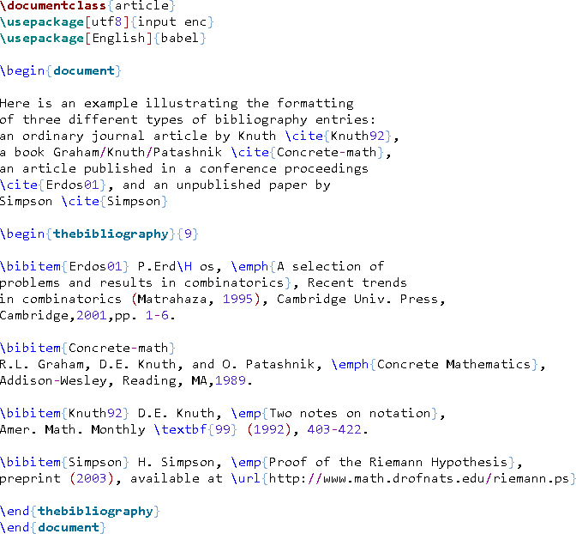
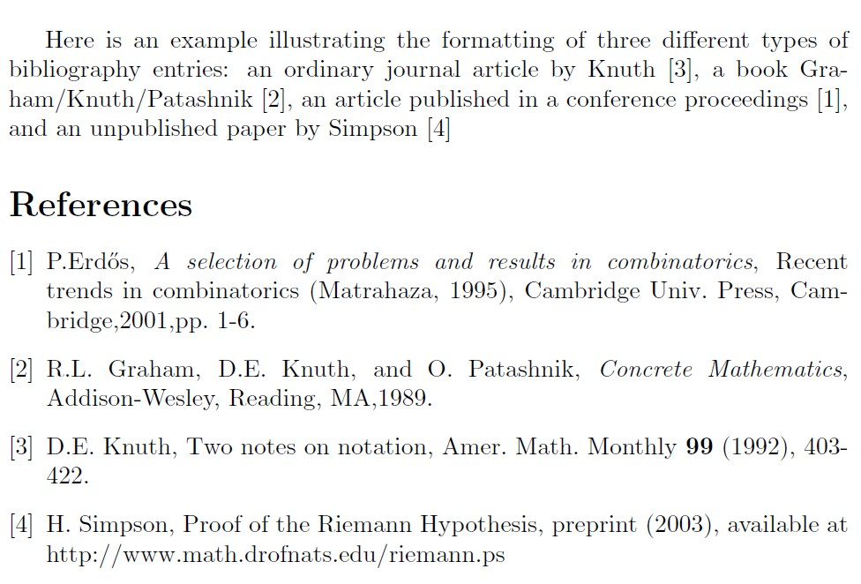
OBJECTIVES
INTRODUCTION
LAT_{E}X BASICS
MATH
IMAGES
BIBLIOGRAPHY
CONCLUSION

Slide 43
OBJECTIVES
INTRODUCTION
LAT_{E}X BASICS
MATH
IMAGES
BIBLIOGRAPHY
CONCLUSION
BIBTEX - SIMPLER & EASIER
Uses structured bibliography .bib file to be included in .tex document
Generates bibliography according to specified style
Write Once, Use many approach

Slide 44
OBJECTIVES
INTRODUCTION
LAT_{E}X BASICS
MATH
IMAGES
BIBLIOGRAPHY
CONCLUSION
BIBTEX ENTRY FORMAT
@entry type{cite key}, field name 1 = “fieldtext” field name 2 = “fieldtext”
... }
entry type - article, book, online, phdthesis, etc.
field name - author, title, volume, year, publisher, etc.
cite key - user defined key to cite the reference
For example, if reference is a book
@book{HK,
author = “H.Kopka and P.W.Daly”, title = “A guide to Latex”, publisher = “Addison-Wesley”, year = 1999.
}

Slide 45
OBJECTIVES
INTRODUCTION
LAT_{E}X BASICS
MATH
IMAGES
BIBLIOGRAPHY
CONCLUSION
USING BIBTEX DATABASE
Import biblatex package
⁾ \usepackage{biblatex}
Tell the compiler which .bib file to use
⁾ \bibliography{bibfile name}
Select bibliographic style
⁾ \bibliographystyle{style}
⁾ Standard styles - plain, ieeetr, alpha, abbrv, unsort
⁾ Publishers often supply their own style files (.bst)
Citing Reference
⁾ \cite{cite key 1, cite key 2, ...}

Slide 46
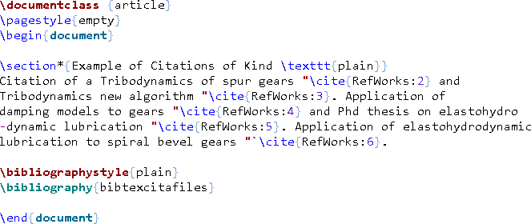
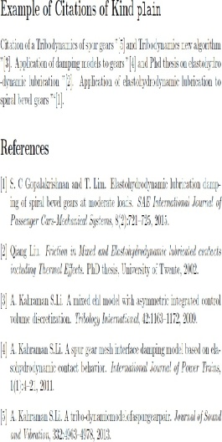
OBJECTIVES
INTRODUCTION
LAT_{E}X BASICS
MATH
IMAGES
BIBLIOGRAPHY
CONCLUSION

Slide 47
OBJECTIVES
INTRODUCTION
LAT_{E}X BASICS
MATH
IMAGES
BIBLIOGRAPHY
CONCLUSION
ONLINE TUTORIALS & RESOURCES
CEAS Library L^{A}T_{E}X resources
http://guides.libraries.uc.edu/latex
Online L^{A}T_{E}X links & tutorials
⁾ Basic Tutorial by Andrew Roberts
⁾ The L^{A}T_{E}X wiki book
⁾ L^{A}T_{E}X Project http://www.latex-project.org/

